Slide 1
Affordable Housing in Kent County
MADS Milestone 1 Project
Alan Fehsenfeld | Koon Leong Ho | George Thio
February 3, 2021

Slide 2
Table of Contents
Executive Summary

Slide 3
Executive Summary
Background
A study published by the Terner Center of the University of California at Berkeley found that housing stability to social improvement as it allows the under privileged to focus on education, employment, and other dimensions of economic mobility. It promotes investments in professional development helped them to keep their jobs by reducing involuntary moves.
Promoting affordable housing, therefore, has the significant positive impact on the community.
The Federal Low Income Housing Tax Credit Program (LIHTC) provides tax credit to promote development of affordable rental housing. In Michigan, this is administered by the Michigan State Housing Development Authority (MSHDA). Projects under the scheme are awarded based on the quality of the proposal and the location as rated by the LIHTC Scoring Criteria. The criteria takes into consideration the following factors:
Proximity to Transportation
Proximity to Amenities
Enterprise 360 Opportunity 360 Score
Walk Score
Distance from Employment Centers
Located in Neighborhood Investment Activity Areas
Affordable/Market Rent Differential
Located in Opportunity or Rising Tide Communities
Motivation
The ability to secure adequate funding is an important determinant of success and financial viability for affordable housing projects. The ability to select locations with the highest scoring criteria, there will be an important competitive advantage for the developers.
Unfortunately, there are not tools that will help developers identify locations with the highest scores. Housing developers often rely on word of mouth to identify potential development sites or visiting potential sites. Decisions can be suboptimal due to the inability to select the best possible location.
This project aims to address this information gap by developing an integrated tool to identify the ideal sites by aggregating multiple sources into a single database and calculate the Score.
A visualization tool will be develop to provide the MSHDA Score for all the properties and show them in the context of the neighborhood.
The scope of this project will focus on Kent County but it can be expanded to cover the entire state of Michigan if the data is available
For details, refer to Scoring Summary for 2021 https://www.michigan.gov/documents/mshda/mshda_li_qap_2021_score_sum_final_708132_7.xls
Improving information flow will allow developers to improve their proposals and align to the government’s housing development priorities.

Slide 4
Python Libraries Used
Some commentary about libraries
Libraries | Usage
Numpy and Pandas
GeoPandas
SQLalchemy
Matplotlib
Plotly
Seaborn

Slide 5
Data Sources
Some commentary about data sources
Data Type | Source | Extraction method
Proximity to Transportation
Proximity to Amenities
Enterprise 360 Opportunity 360 Score
Walk Score
Distance from Employment Centers
Located in Neighborhood Investment Activity Areas
Affordable/Market Rent Differential
Located in Opportunity or Rising Tide Communities
Geospatial shapefiles

Slide 6
Data Manipulation
Some commentary about data manipulation
Data Type | Manipulation
Proximity to Transportation
Proximity to Amenities
Enterprise 360 Opportunity 360 Score
Walk Score
Distance from Employment Centers
Located in Neighborhood Investment Activity Areas
Affordable/Market Rent Differential
Located in Opportunity or Rising Tide Communities

Slide 7
Data management strategy

Slide 8
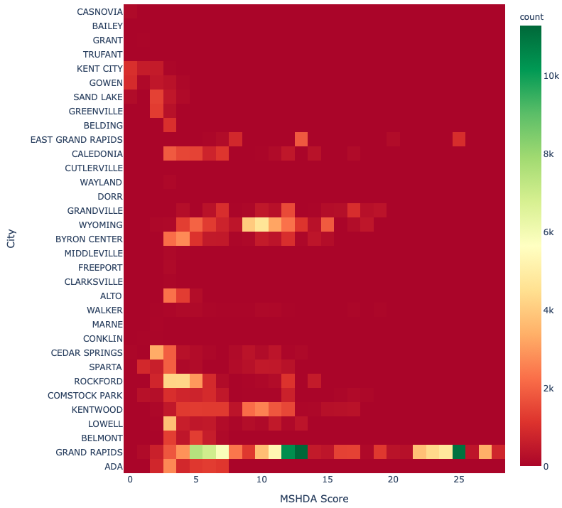
Analysis and Visualization
Distribution of properties with high MSDHA Scores
Commentary

Slide 9
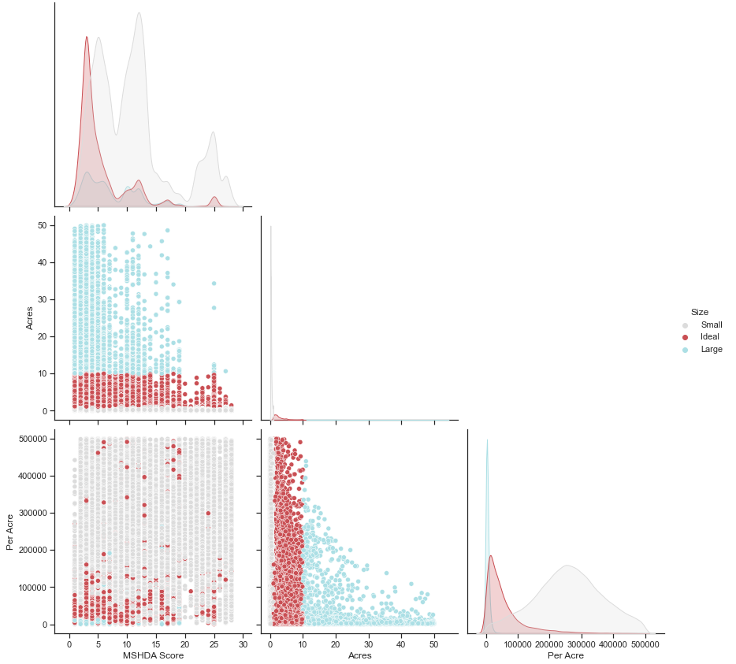
Distribution of ideal size plots

Slide 10
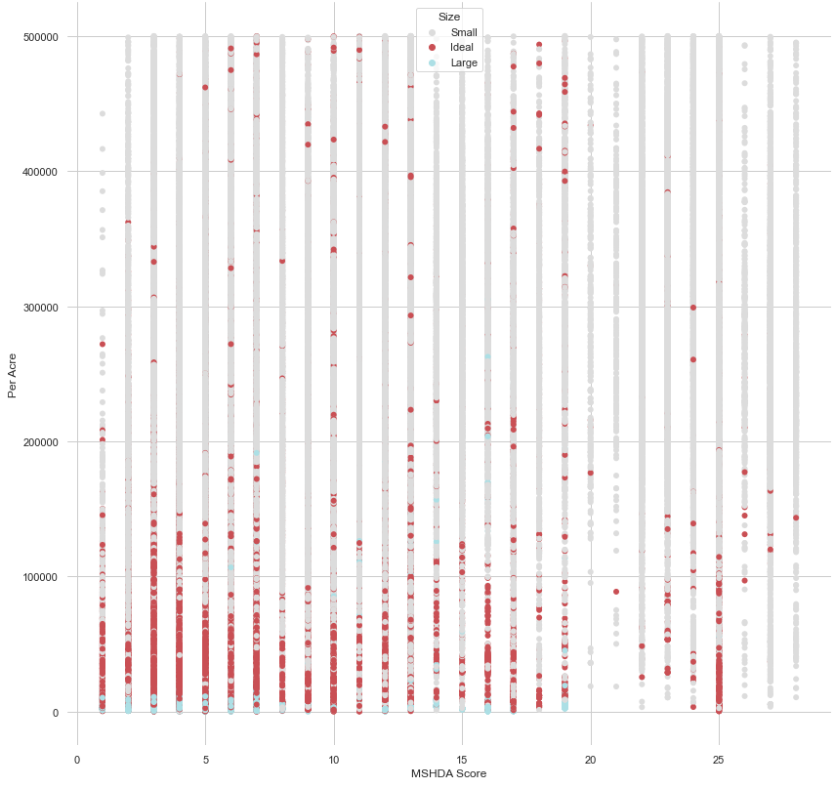
MSDHA score vs Cost per acre

Slide 11
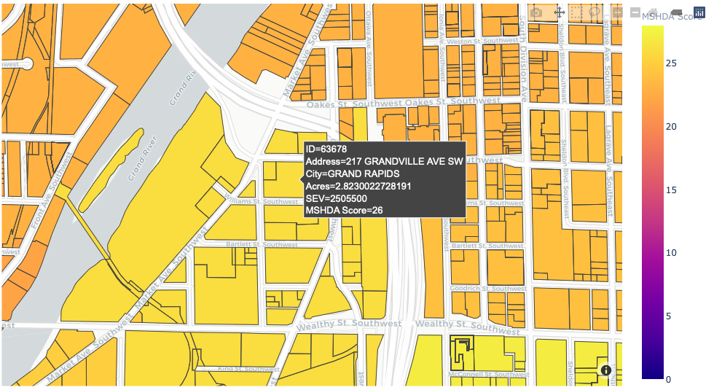
Plot level information

Slide 12
Future enhancements

Slide 13
Statement of Work

Slide 14
Future Enhancement References & acknowledgements
References
Acknowledgements

